Slide 1

UNIVERSITY INSTITUTEOF ENGINEERING
Bachelor of Engineering (Computer Science & Engineering)
Operating System (CST-328)
Subject Coordinator: Er. Puneet kaur (E6913)
Introduction to Operating System
DISCOVER . LEARN . EMPOWER
Font size 24

Slide 2
Lecture 15 Swapping , Fragmentation & Compaction

Slide 3
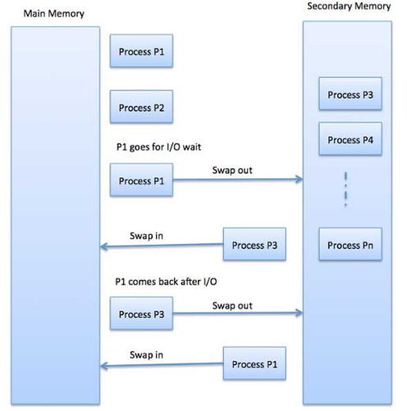
Swapping
Swapping is a mechanism in which a process can be swapped temporarily out of main memory (or move) to secondary storage (disk) and make that memory available to other processes.
A process can be swapped temporarily out of memory to a backing store, and then brought back into memory for continued execution
Swapping is also known as a technique for memory compaction.

Slide 4
Swapping
Backing store – fast disk large enough to accommodate copies of all memory images for all users; must provide direct access to these memory images
Roll out, roll in – swapping variant used for priority-based scheduling algorithms; lower-priority process is swapped out so higher-priority process can be loaded and executed
Major part of swap time is transfer time; total transfer time is directly proportional to the amount of memory swapped
Does the swapped out process need to swap back in to same physical addresses? Depends on address binding method

Slide 5

Swapping Time
100MB process swapping to hard disk with transfer rate of 50MB/sec Swap out time of 2000 ms
Plus swap in of same sized process
Total context switch swapping component time of 4000ms (4 seconds)
Let us assume that the user process is of size 2048KB and on a standard hard disk where swapping will take place has a data transfer rate around 1 MB per second. The actual transfer of the 1000K process to or from memory will take

Slide 6
Swapping Advantage/Disadvantage
Advantages of Swapping
It helps the CPU to manage multiple processes within a single main memory.
It helps to create and use virtual memory.
Swapping allows the CPU to perform multiple tasks simultaneously. Therefore, processes do not have to wait very long before they are executed.
It improves the main memory utilization.
Disadvantages of Swapping
If the computer system loses power, the user may lose all information related to the program in case of substantial swapping activity.
If the swapping algorithm is not good, the composite method can increase the number of Page Fault and decrease the overall processing performance.
Note:
In a single tasking operating system, only one process occupies the user program area of memory and stays in memory until the process is complete.
In a multitasking operating system, a situation arises when all the active processes cannot coordinate in the main memory, then a process is swap out from the main memory so that other processes can enter it.

Slide 7
Fragmentation
External Fragmentation – total memory space exists to satisfy a request, but it is not contiguous
Internal Fragmentation – allocated memory may be slightly larger than requested memory; this size difference is memory internal to a partition, but not being used
First fit analysis reveals that given N blocks allocated, 0.5 N blocks lost to fragmentation 1/3 may be unusable -> 50-percent rule

Slide 8
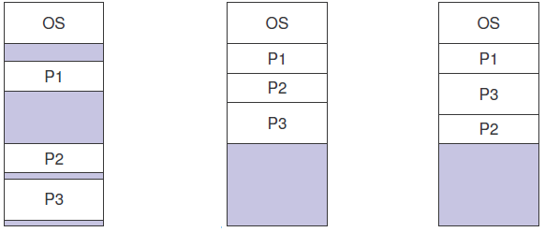
Compaction
If a program is moved out or terminates, it creates a hole, (i.e. a contiguous unused area) in main memory. When a new process is to be moved in, it may be allocated one of the available holes. It is quite possible that main memory has too many small holes at a certain time. In such a situation none of these holes is really large enough to be allocated to a new process that may be moving in. The main memory is too fragmented. It is, therefore, essential to attempt compaction. Compaction means OS re-allocates the existing programs in contiguous regions and creates a large enough free area for allocation to a new process.

Slide 9
Compaction
Reduce external fragmentation by compaction Shuffle memory contents to place all free memory together in one large block
Compaction is possible only if relocation is dynamic, and is done at execution time
I/O problem Latch job in memory while it is involved in I/O
Do I/O only into OS buffers

Slide 10
Swapping Practice example
Que: Suppose the user process's size is 2048KB and is a standard hard disk where swapping has a data transfer rate of 1Mbps. Calculate how long it will take to transfer from main memory to secondary memory.
Sol: User process size is 2048Kb
Data transfer rate is 1Mbps = 1024 kbps
Time = process size / transfer rate
= 2048 / 1024
= 2 seconds
= 2000 milliseconds
Now taking swap-in and swap-out time, the process will take 4000 milliseconds.

Slide 11
Conclusion
This lecture makes the student familiar with Memory allocation techniques like contiguous allocation, partitioned allocation and dynamic allocation techniques.

Slide 12
Video Link
https://www.youtube.com/watch?v=SqYigYLFvcI
https://www.youtube.com/watch?v=ZN-baY3x85o
https://www.youtube.com/watch?v=buRdtPIieOM

Slide 13
References
https://www.tutorialspoint.com/operating_system/os_memory_management.htm
https://www.studytonight.com/operating-system/memory-management
https://www.guru99.com/os-memory-management.html
https://www.geeksforgeeks.org/partition-allocation-methods-in-memory-management/
https://www.javatpoint.com/os-memory-management-introduction
http://www2.latech.edu/~box/os/ch08.pdf
https://www.cs.uic.edu/~jbell/CourseNotes/OperatingSystems/8_MainMemory.html#:~:text=8.3%20Contiguous%20Memory%20Allocation,allocated%20to%20processes%20as%20needed.
http://www.csdl.tamu.edu/~furuta/courses/99a_410/slides/chap08

